Slide 1
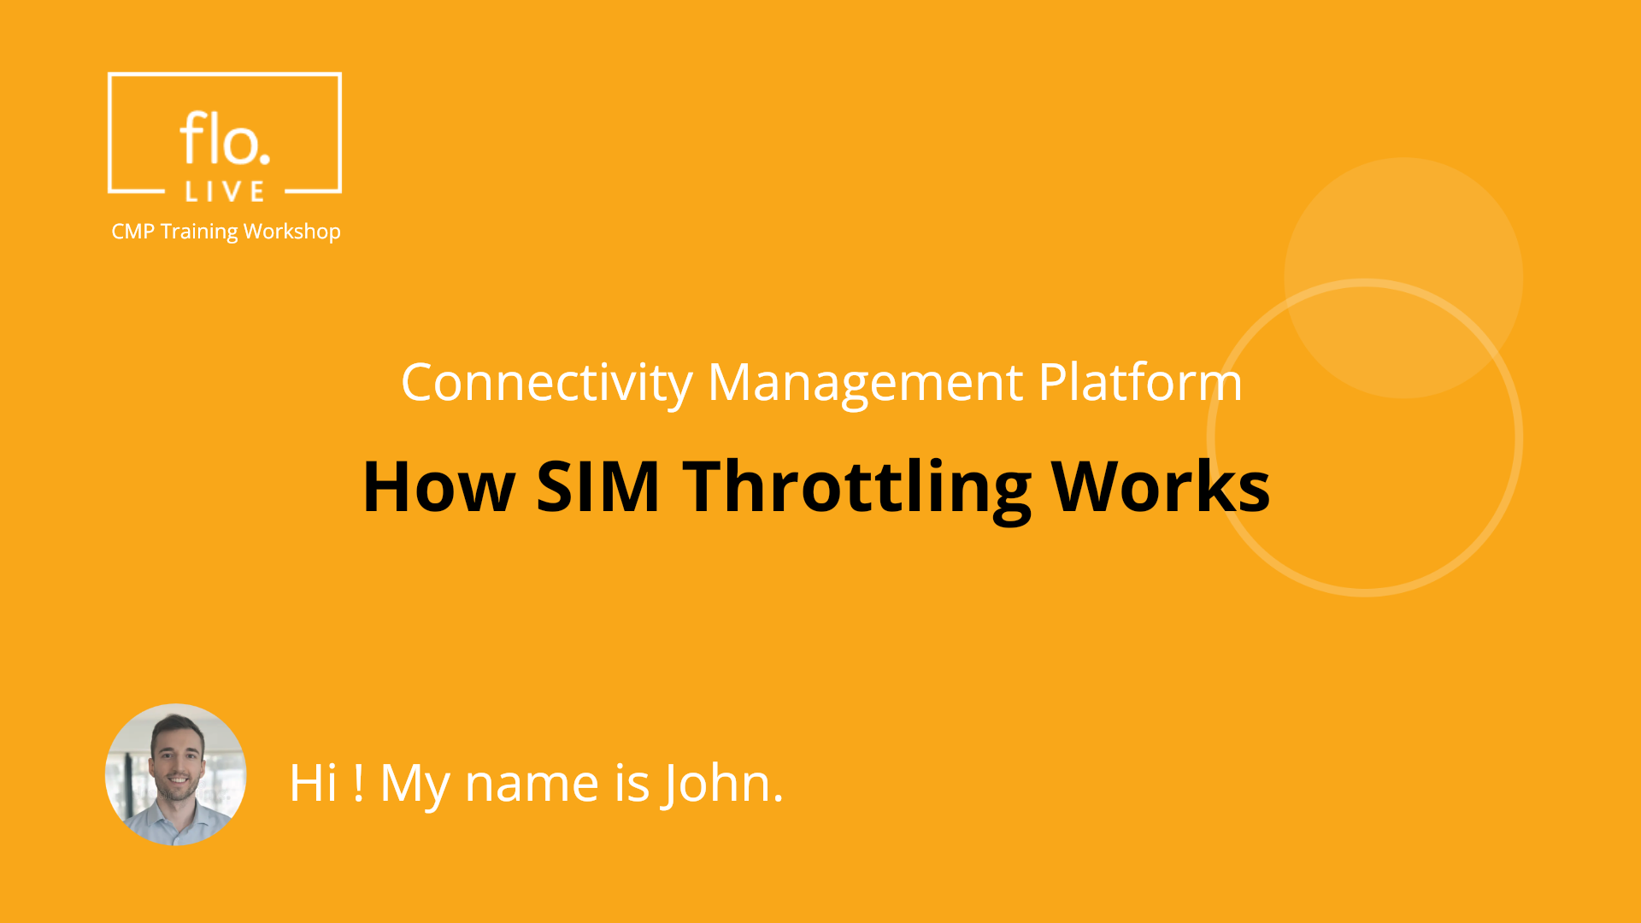
Notes:
Hi, My name is John and welcome to the CMP Training Workshop

Slide 2
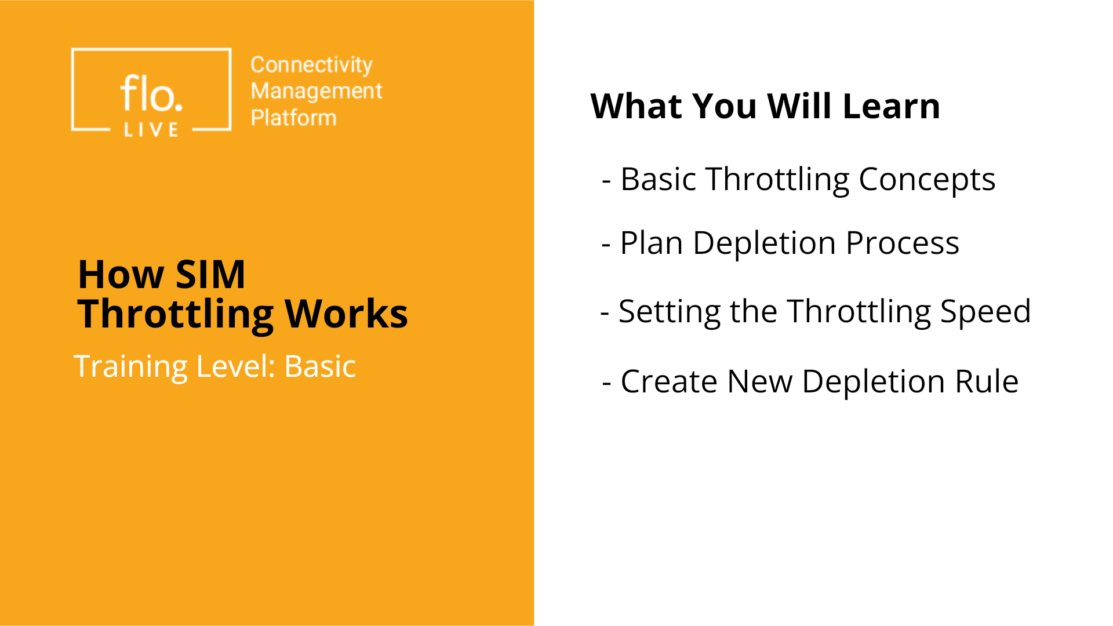
Notes:
In this workshop, we cover the basics of SIM throttling. We will talk about the Plan Depletion process, which is what happens when data is consumed. We then describe how to set the throttling speed by selecting an appropriate PCRF system code. Finally, you will learn how to create a new Depletion Rule, so you can set up throttling for your own SIMs. Let's get started!

Slide 3
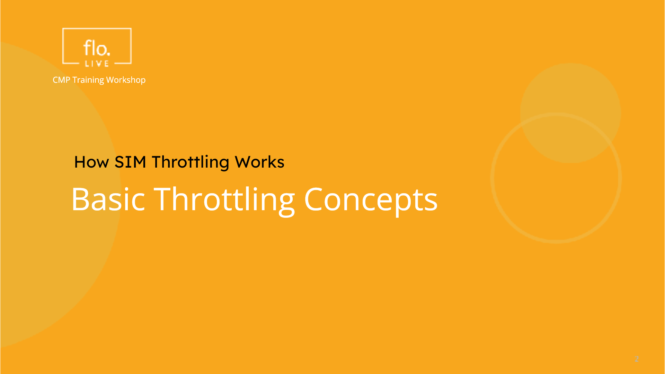
Notes:
To begin this tutorial, lets explore the concept of throttling to understand why it is used.

Slide 4
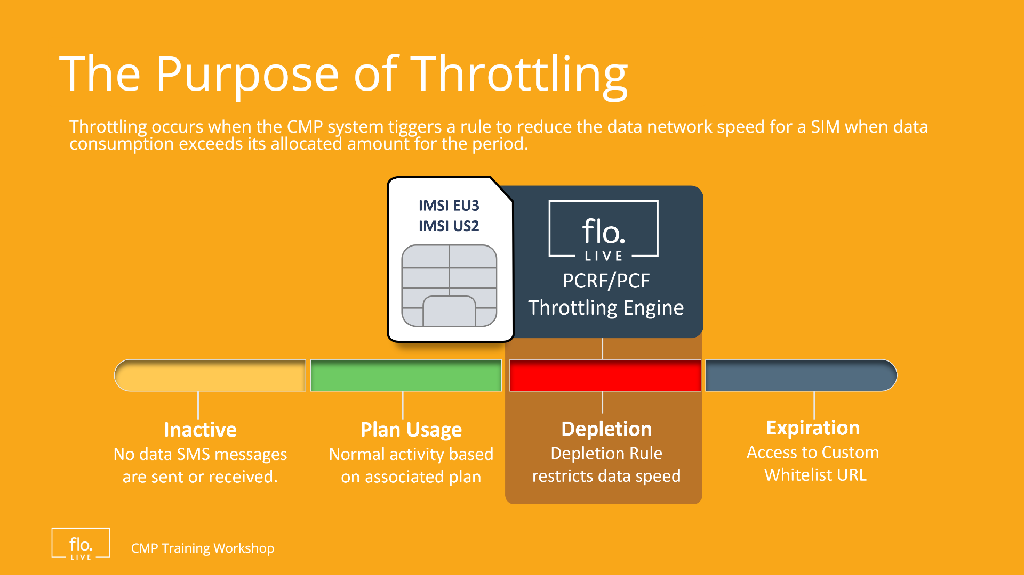
Notes:
The purpose of throttling is to prevent unexpected data usage when consumption exceeds the amount of data allocated by the plan. SIM throttling is achieved by activating a "Depletion" rule that reduces throughput speed to a predefined setting.

Slide 5
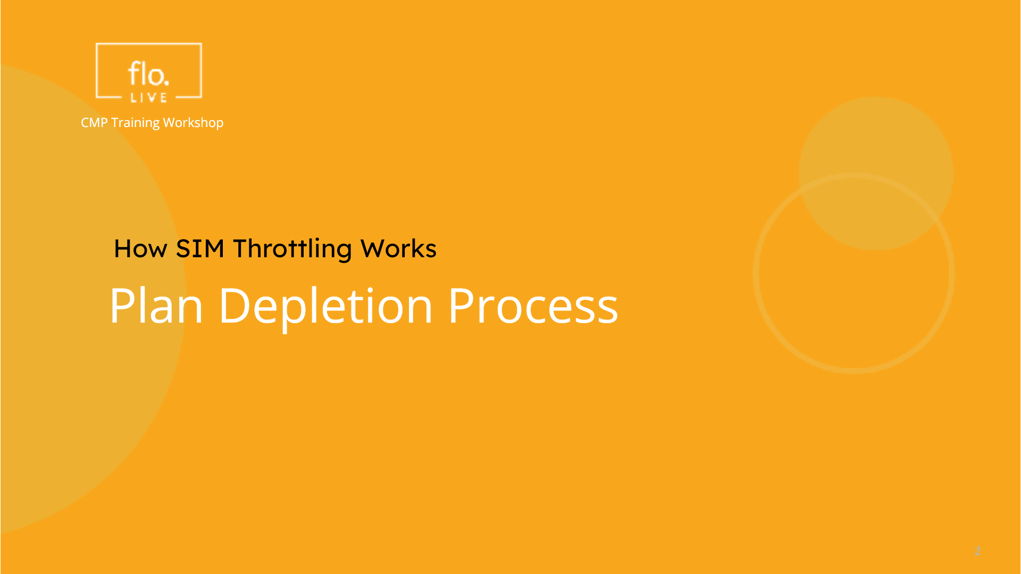
Notes:
Now that we understand the importance of SIM throttling, lets take a look at how the Plan Depletion process works.

Slide 6
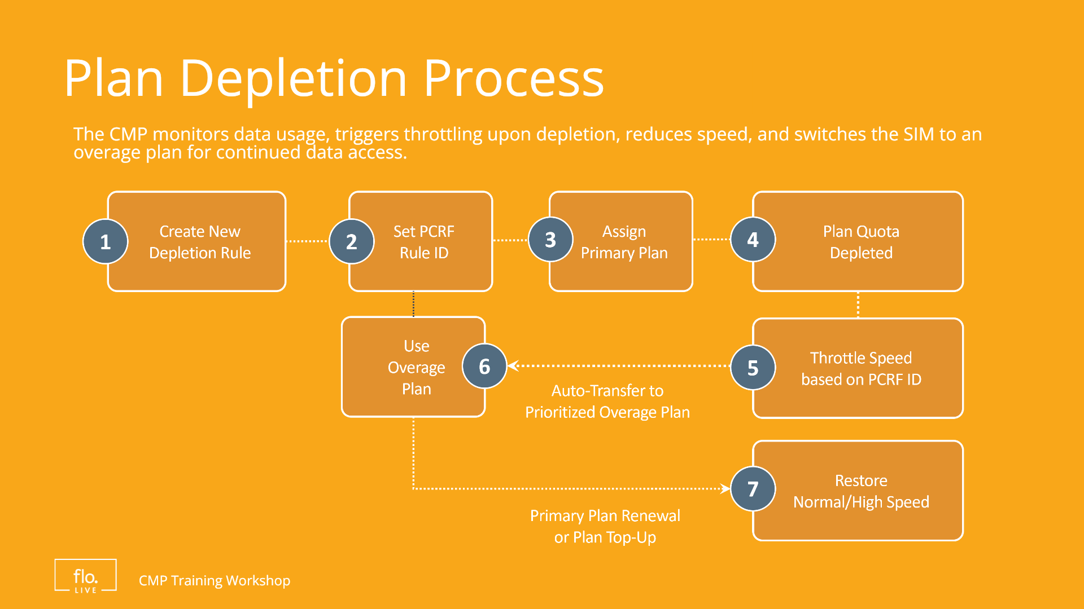
Notes:
To activate throttling, you need to create a new Depletion Rule which specifies a reduced speed for a specific account and plan. The CMP continuously monitors data usage and identifies when an active SIM reaches the plan threshold. When the plan is depleted, the CMP PCRF component automatically triggers a throttling action to enforce the configured speed limit. After throttling is activated, the device is automatically transferred to a different prioritized plan. This method allows continue data usage at a lower speed and ensures persistent connectivity until plan renewal or plan top up.

Slide 7
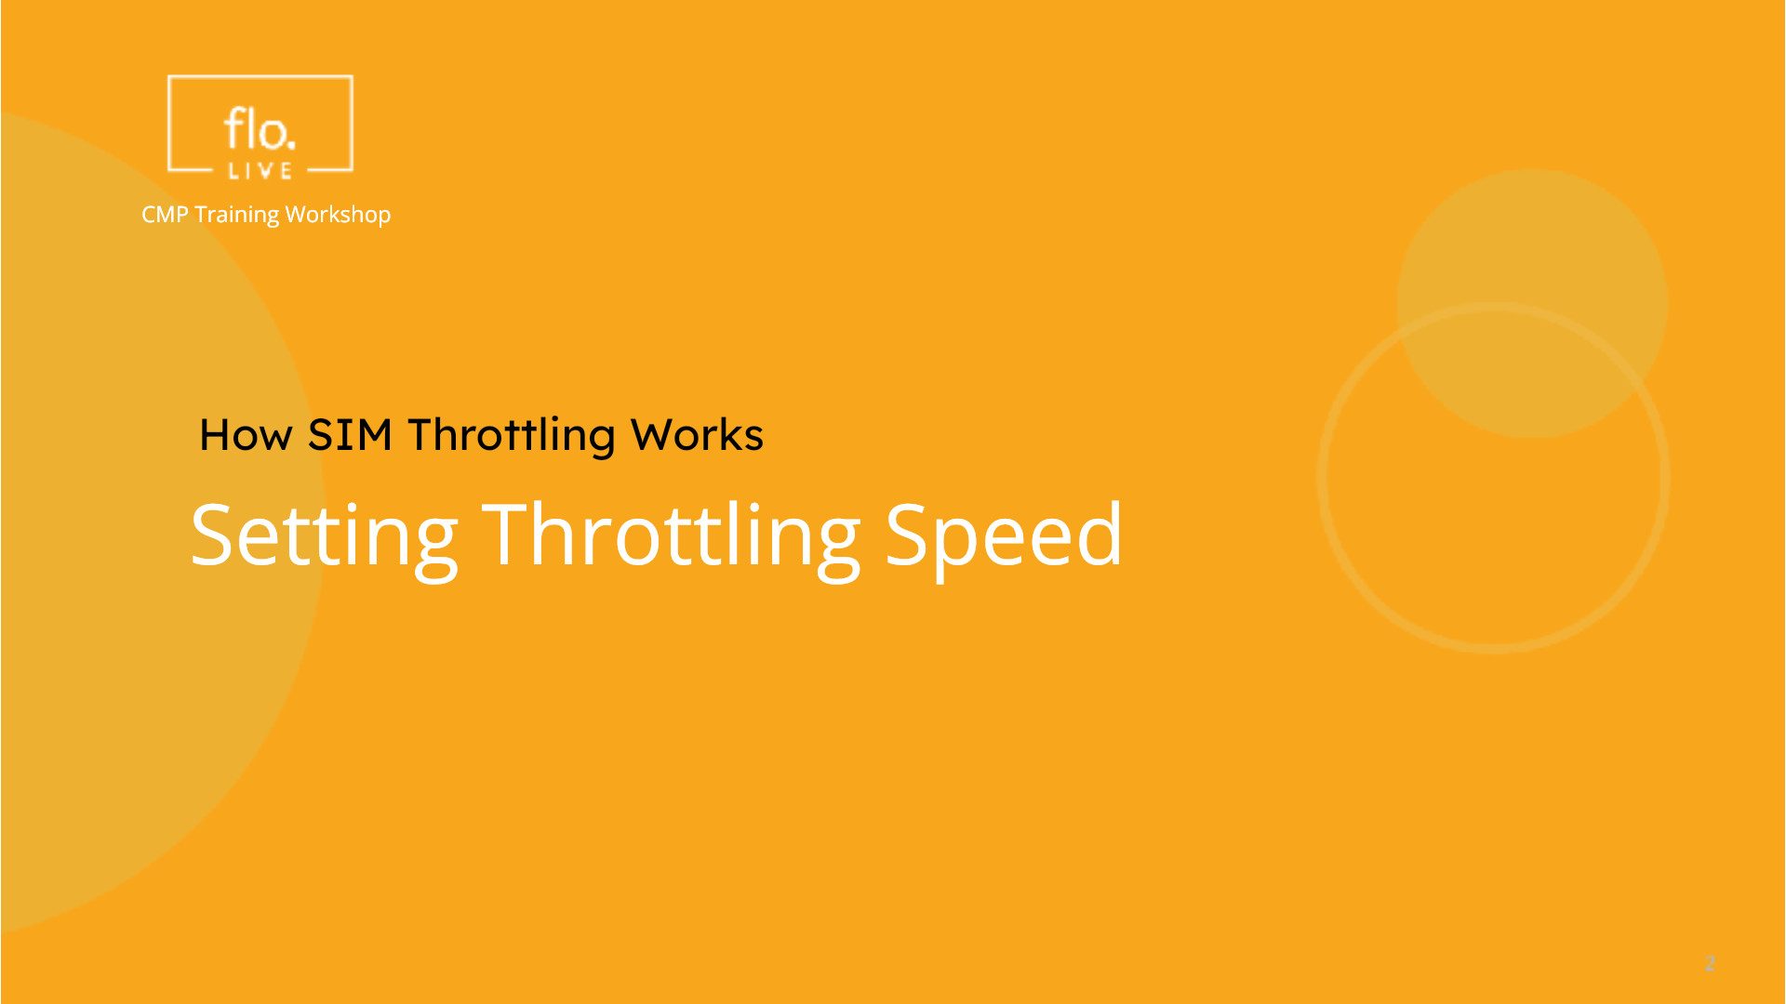
Notes:
Now that we know how SIM throttling works, lets take a look at how you can set the throttling speed for a depleted plan.

Slide 8
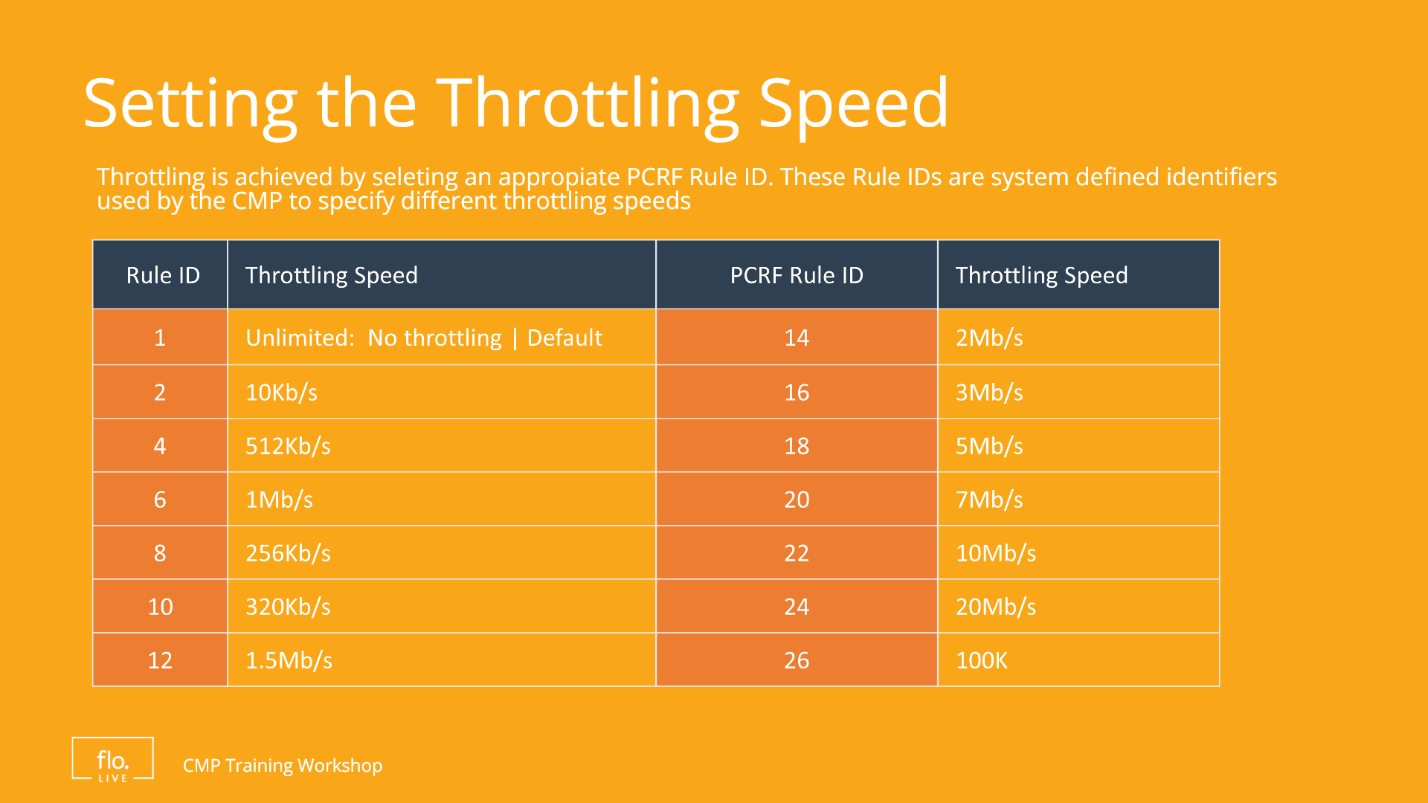
Notes:
Throttling is implemented by the use of PCRF Rules. These are system defined identifiers that determine how and when data speeds are limited or prioritized. Throttling speeds range from very low, like 10Kb/s for basic background tasks, to higher speeds such as 7Mb/s or 10Mb/s for streaming and heavy data usage. Choosing the right speed depends on the desired balance between user experience and fair usage.

Slide 9
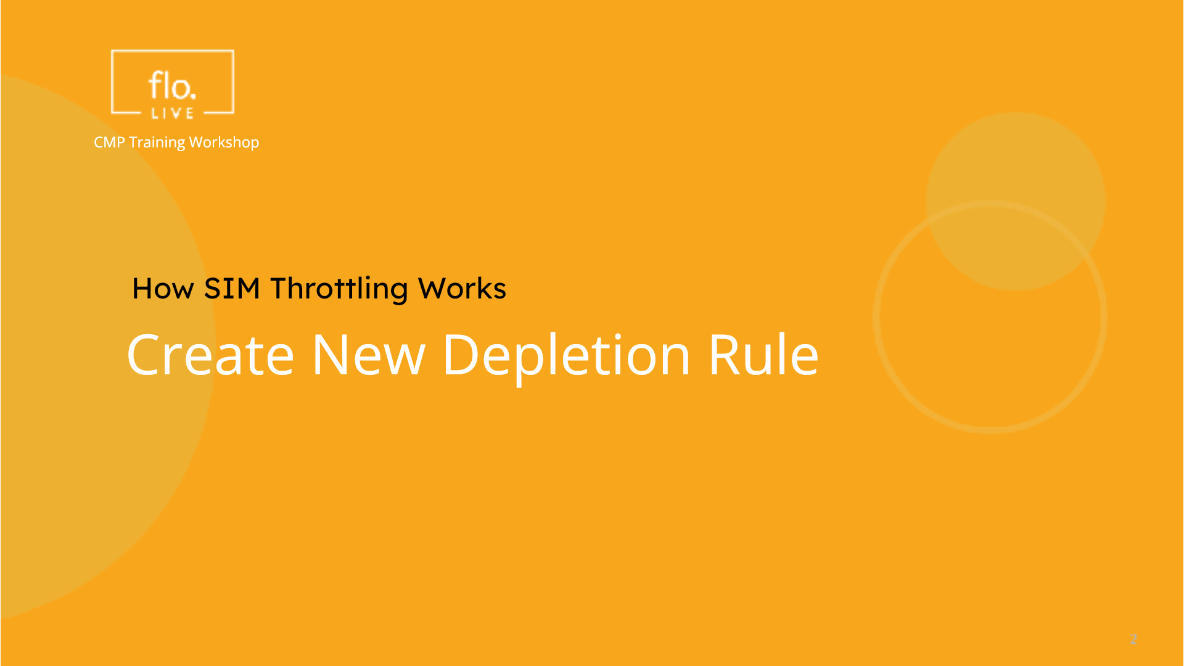
Notes:
To complete this tutorial, lets create a new Depletion Rule and set the throttling speed.

Slide 10
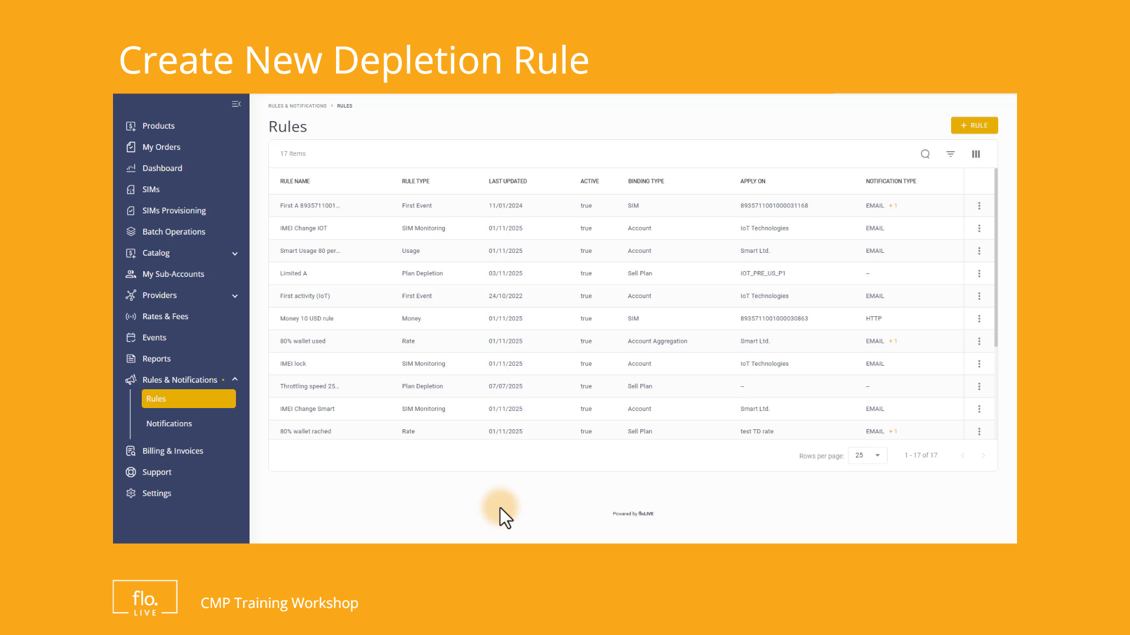
Notes:
Select Rules on the sidebar menu, and then click the "Add Rule button to display the Create Rule dialog box. Now go to the Rule Type field and select the Plan Depletion option. and then select Sell Plan in the Binding type file. . Now select Usage or Money from the Rule Type field to display the Rule settings. Type a Rule Name As an option, you can provide a Rule Description to provide more information about the new rule. Go to the Apply On field and select the Account Name and Plan Name to specify where the rule applies. Now select Data Service in the Service Type filed. Dont forget to select the Add PCRF Rule check box and specify an appropriate Rule ID to set the throttling speed. Finally click the "Create" button to save the rule. and that's it! You've successfully added a PCRF Depletion Rule.

Slide 11

Notes:
Thank you for watching this video tutorial. For more information about the CMP system, make sure you visit our Knowledge-base that is accessible directly from the CMP Portal.

